Slide 1
Identifying Functionality : CRC Cards and State Diagram
Session 18
(Lecture)
Course : Program Design Methods
Effective Period : July 2018

Slide 2
These slides have been adapted from
Britton, C.. (2005). A student Guide to Object Oriented Development. 01. Butterworth-Heinemann. Amsterdam. ISBN: 978-0-7506-6123-2. Chapter 6 - 7
Acknowledgement

Slide 3
LO 5 : Explain the object oriented design
Learning Objectives

Slide 4
Contents
Introduction to CRC card
Identifying operations using the CRC card techniques
Introduction to State Diagram
States and Events
Constructing a state diagram

Slide 5
Introduction
CRC technique is used to allocate responsibilities to classes and work out the interaction between classes that is required to implement the use case scenario. These responsibility then turn into operations.

Slide 6
Identifying operation using the CRC Card technique
CRC (class-responsibility-collaboration) cards are not officially part of UML, but are regarded as a valuable technique that works extremely well with it.
at this stage, the aim is to look at the overall functionality of the system as identified in the use cases, and divide it up between the classes.
Each class is regarded as having certain responsibilities to provide services to the user of the system or to another class.
Each responsibility identifies something that a class is expected to do

Slide 7
CRC Cards
The aim of the CRC card technique is to divide the overall functionality of the system into responsibilities which are then allocated to the most appropriate classes

Slide 8
Example
Scenario for the ‘Issue Bike’ use case showing the objects that will carry out the different responsibilities Stephanie arrives at the shop at 9.00 am on Saturday and chooses a mountain bike Annie sees that its number 468 Annie enters this number into the system The system confirms that this is a woman’s mountain bike and displays the daily rate(£2) and the deposit(£60) (:Bike) Stephanie says she wants to hire the bike for a week Annie enters this and the system displays the total cost £14 + £60 = £74 (:Bike) Stephanie agrees this Annie enters Stephanie’s name, address and telephone number into the system (:Customer) Stephanie pays the £74 Annie records this on the system and the system prints out a receipt (:Payment collaboration with :Customer) Stephanie agrees to bring the bike back by 9.00 am on the following Saturday

Slide 9
Example
Customer
Responsibility | Collaborator
Provide customer information Keep track of hire transaction Add new payment objects | Hire Payment
Bike
Responsibility | Collaborator
Provide bike information Calculate the hire cost for a specified number of days
Payment
Responsibility | Collaborator
Keep a record of all customer payments Calculate and store amount of deposit returned Issue receipt | Hire Customer
Hire
Responsibility | Collaborator
Provide details of a hire transaction Deal with the processing of a bike return, i.e know if it is late; calculate and store lateness penalty. Store any damage penalty | Bike

Slide 10
Deriving operations from
CRC responsibilities
We must ensure that each class has the data and operations needed to fulfill its responsibilities in the way that the user requires
Use case description can guide to identify the operation

Slide 11
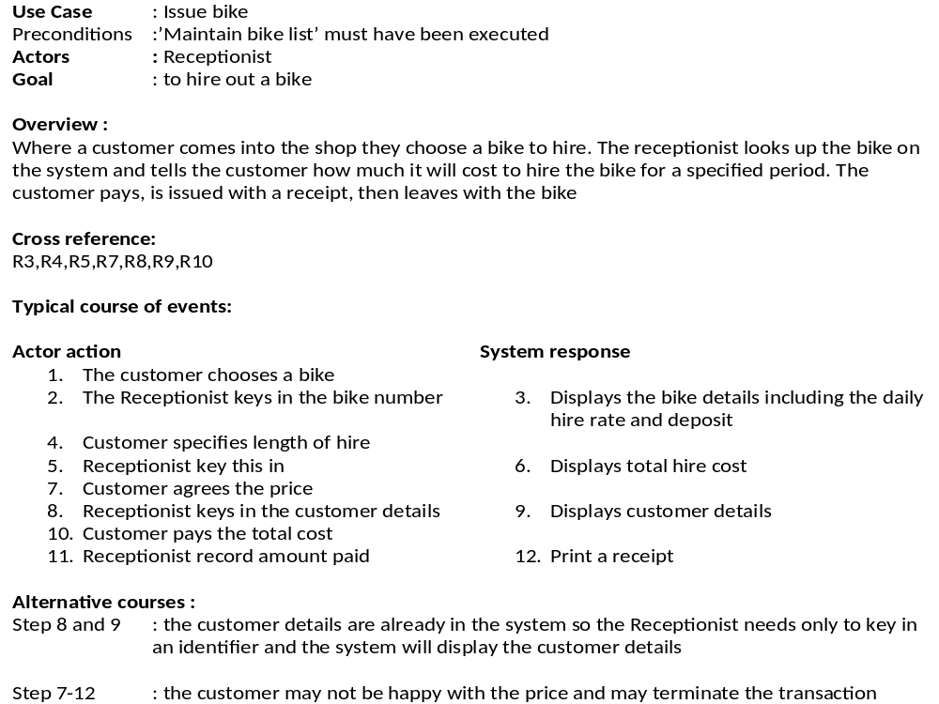
findBike(bike#)

Slide 12
getCharges(no.dys)

Slide 13
recordDetails(custID,name, address,tel)

Slide 14
calcTotalPayment()
issueReceipt()

Slide 15
Hire(startDate,no.Days)

Slide 16
Operation
Bike | findBike(bike#) getCharges(no.Days) Bike()
Customer | recordDetails(custID,name,address,tel) customer()
Payment | calcTotalPayment() issueReceipt() Payment()
Hire | Hire(startDate,no.Days)

Slide 17
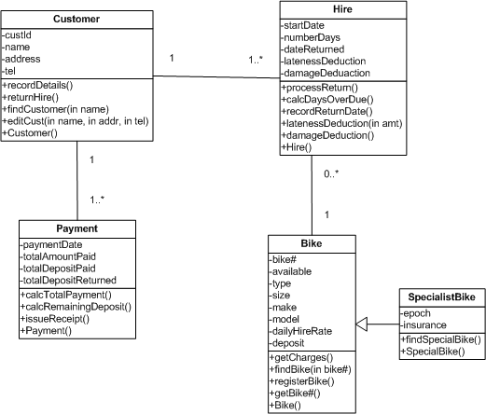
Completed class diagram

Slide 18
Interaction Diagram
Interaction diagram model the messaging between a collaboration of objects that will take place in the execution of a specific scenario
There are two types of interaction diagram
  Sequence Diagrams
  Collaboration Diagrams

Slide 19
Sequence diagram
Sequence diagrams show clearly and simply the flow of control between objects required to execute a scenario
A scenario outlines the sequence of steps in one instance of a use case from the user’s side of the computer screen, a sequence diagram shows how these steps translate into messaging between objects on the computer’s side of the screen

Slide 20
Notation
A message is represented as a labeled arrow form one object lifeline (the sender) to another (the recepient)
The sequence of messages is read from the top of the page to the bottom
Returned values are usually shown on the message line. the return value is assigned to a variable.
Return of control can be indicated in UML by a dashed arrow. Return arrow is not a new message but models the return of control to the sending object
Object activation is shown by a thin rectangle on the object’s lifeline. An object becomes active as soon as it receives a message.

Slide 21
Example
Scenario for the ‘Issue Bike’ use case showing the objects that will carry out the different responsibilities Stephanie arrives at the shop at 9.00 am on Saturday and chooses a mountain bike Annie sees that its number 468 Annie enters this number into the system The system confirms that this is a woman’s mountain bike and displays the daily rate(£2) and the deposit(£60) Stephanie says she wants to hire the bike for a week Annie enters this and the system displays the total cost £14 + £60 = £74 Stephanie agrees this Annie enters Stephanie’s name, address and telephone number into the system Stephanie pays the £74 Annie records this on the system and the system prints out a receipt Stephanie agrees to bring the bike back by 9.00 am on the following Saturday

Slide 22
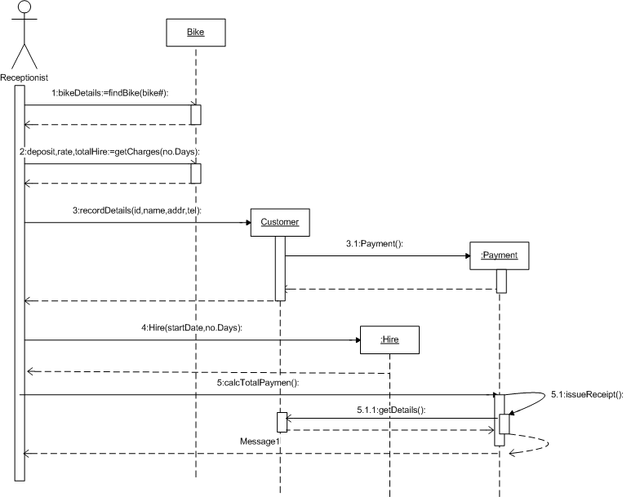

Slide 23
Collaboration Diagram
The collaboration diagram almost same with the sequence diagram, but the difference are :
  Messages are not shown in time sequence, so numbering becomes essential to indicate the order of the messages
  Links between objects are explicitly modeled, which is not the case with the sequence diagram
  Messages are grouped together on the object links
  Messages are shown as text labels with an arrow that points from the client to the server
  Return are never modeled in a collaboration diagram

Slide 24
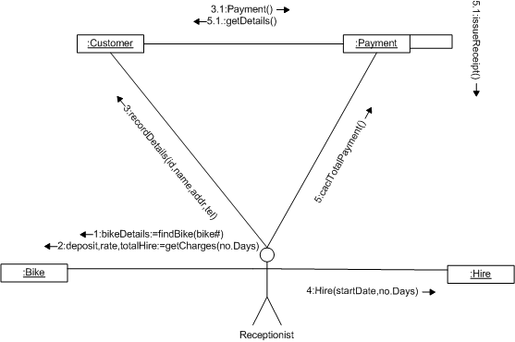

Slide 25
Specifying operations
Some of the approaches for specifying operations are :
  Specification by contract : describes operations in terms of services they deliver
  Structured English : is a limited and structured subset of natural language, with syntax that is similar to that of block structured programming language
  Using a decision table or decision tree : it is used when an operation involves a number of decisions

Slide 26
References
Britton, C.. (2005). A student Guide to Object Oriented Development. 01. Butterworth-Heinemann. Amsterdam. ISBN: 978-0-7506-6123-2.
CRC, http://www.agilemodeling.com/artifacts/crcModel.htm
State Diagram, http://www.agilemodeling.com/artifacts/stateMachineDiagram.htm

Slide 27
Q & A

